Slide 1
Co-training Embeddings of Knowledge Graphs and Entity Descriptions for Cross-lingual Entity Alignment
Muhao Chen, Yingtao Tian, Kai-WeiChang, Steven Skiena, Carlo Zaniolo
Xiaofan Yan

Slide 2
Outline
Abstract
Introduction
Modeling
Experiments
Conclusion and future work

Slide 3
Abstract
Multilingual KG embeddings provide latent semantic representations of entities and structured knowledge with cross-lingual inferences.
Challenge: low coverage of entity alignment
Introduce an embedding-based approach which leverages a weakly aligned multilingual KG for semi-supervised cross-lingual learning using entity descriptions

Slide 4
Introduction
KG for NLP-related task
Relation extraction
Ontology population
Question answering
Dialogue agents
Visual semantic labeling
Connect KG structures
Mutilingual
Knowledge alignment
Cross-lingual QA
Machine-translation

Slide 5
Introduction
Challenge
cross lingual knowledge
inter-lingual links(ILLs) match cross lingual counterparts of entities
Method
Propose a novel co-training-based approach KDCoE, which trains two component embedding models on multilingual KG structures and entity descriptions.
formed as

Slide 6
Introduction
KG embedding model
Jointly train
Translational knowledge model
Linear-transformation-based alignment
To encode KG structure
Description embedding
Employ
Attentive gated recurrent unit encoder
Multilingual word embeddings
To characterize multilingual entities embedding

Slide 7
Related work
Monolingual KG embedding
TransE, TransH, TransR, TransD, TransA
Differences: forms of relation-specific projrctions
DistMult, HolE, ConvE
Non-translational models

Slide 8
Related work
Multilingual KG embedding:
MTransE: connects monolingual model with a jointly trained alignment model
JAPE: strengthen MTransE based on the similarity of entity attributions
ITransE: self-training
LM, CCA: off-line training
OT: orthogonal-transformation based
Co-training: combine multiple models to learn different views of the data to enhance the supervision by taking turn in suggesting more labels

Slide 9
Modeling
KDCoE
KGEM -- capture embeddings with cross-lingual inferences for structured knowledge
DEM -- entity descriptions
Co-training -- propose new ILLs with high confidence to populate

Slide 10
Modeling
Multilingual KG Embeddings
Preserve entities and relations in a separated embedding space
Multilingual Entity Description Embeddings
An attentive gated recurrent unit encoder (AGRU) is used to encode the multilingual entity descriptions. On top of that, DEM is trained to collocate the description embeddings of cross-lingual counterparts.
Iterative Co-training
The co-training of the two model components is conducted iteratively on the KG, where a small amount of ILLs is provided for training.

Slide 11
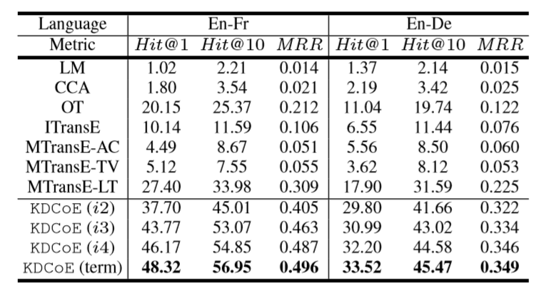
Experiments
Cross-lingual entity alignment
match the same entities from different languages in KB

Slide 12
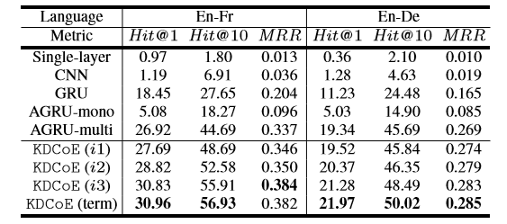
Experiments
Zero-shot alignment
align entities that do not exist in the structure of KG.

Slide 13
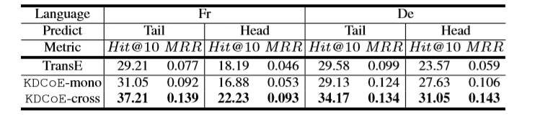
Experiments
Cross-lingual KG Completion
Compare the KGEM of KDCoE against its monolingual counterpart TransE for KG completion, based on the sparser French and German versions.
Monolingual prediction (KDCoE-mono)
Cross-lingual prediction

Slide 14
Conclusion and future work
Propose a semi-supervised learning approach to co-train multilingual KG embeddings and the embeddings of entity descriptions for cross-lingual knowledge alignment.
And able to enhance the traditional methods of KG completion

